Slide 1
Evaluating News Project
Alexis Smith-McCoy

Slide 2
How will Biden’s climate plan affect everyday life -Daily Mail
The first question I asked myself when reading about “How will Biden’s climate plan affect everyday life” is does the headline match the article? The answer is yes: “Industry leaders say Biden's climate plan, while there are no cost specifics yet, could end up costing American taxpayers trillions of dollars.” (Daily News). After asking myself that question I did some lateral reading and found out that the article was published on April 22,2021 at 5:39pm and last updated on April 27, 2021 at 10:58 am. The writer was Emily Krane. Based off on the fact that the article was updated days after it was published makes it seem not credible so far.

Slide 3
How will Biden’s climate plan affect everyday life- Daily Mail
The next question I asked myself while reading is does the article match the news story it's lifted from? The answer is yes because throughout the article there is underlined words in blue and when clicked on they take you to similar articles such as, “Bjorn Lomborg, a visiting fellow at Stanford University, told the OC Register that the plan will likely cost taxpayers about $3,500 per year.”(Daily News). Another question I asked was are the quotes in context? The answer is no because after the article implemented quotes they didn't provide us with before and after sentences about the quote: “David Williams, president of the Taxpayers Protection Alliance, told DailyMail.com that Biden's plan is just a 'multi-trillion dollar corporate welfare giveaway'. 'Strict climate mandates/targets will disproportionately hurt lower and middle income citizens who will be forced to pay higher electricity bills,' he said.” (Daily Mail). Therefore the article does not use quotes in context which is a warning sign.

Slide 4
How will Biden’s climate plan affect everyday life- Daily Mail
The next question you must ask yourself when reading this article to see if its credible or not is does the story have a generic enemy? The answer is bias because throughout the article they are in some parts of the article they favor Biden but in other parts of the article they don't: “But he is yet to release any firm details on exactly how such a plan will affect the daily lives of ordinary Americans” (Daily Mail). By Daily Mail making this statement about President Joe Biden withholding information about the climate plan there are saying that it will have a major effect on people’s lives. A question that you should be asking from the beginning of reading this article is the story set in the future? The answer to the question is no because Daily Mail got information from studies to say how the climate plan will affect lives: “More than half of new cars bought in the United States would need to be electric within the next decade, studies show” (Daily Mail). Daily Mail got there answer to the reason why the climate plan will affect lives by putting studies in the report.

Slide 5
How will Biden’s climate plan affect everyday life- Daily Mail
The following question I asked myself in order to see if the article was credible was did the writer engage with anyone who disagrees? The answer is yes because the author Emily Krane included where the Republicans stand on Biden’s plan: “Biden says he can create millions of good-paying jobs in his plan but many Republicans say it will actually damage the economy. “ (Daily Mail). Republicans don’t agree with Biden’s plan and say how it would do more harm than good and the economy will be damaged. The next step I took in order to find out if the article was credible or not is asking myself does the news source appear to employ editors? The answer to this question is yes Daily Mail has editors that edit their articles, “Geordie Greig is the Editor of the Daily Mail, and also Editor of Mail Newspapers.” (Daily Mail). I had to search up who is their editor because I wasn’t able to find it on their website which is suspicious.

Slide 6
How will Biden’s climate plan affect everyday life- Daily Mail
The next question you have to ask yourself is are you asked to rely on one killer factoid? The answer is no because in the article they included multiple videos and images to make their article seem credible. The last question you should ask yourself is are you told, “trust me”? Even though you're not told directly to trust them throughout the article there is links to underlying articles and they explained where the their facts came from: “The University of Maryland's School of Public Policy estimated that cleaning up transportation would count towards about a quarter of Biden's goal.” (Daily Mail). Including where they got there sources from makes them seem credible. When using lateral reading to examine the article you can find out that Daily Mail has been known for being unreliable, and “widely criticised for its printing of sensationalist and inaccurate scare stories of science and medical research,and for instances of plagiarism and copyright infringement.” (Wikipedia). Even though they have received awards for there “hard work” there still unreliable.

Slide 7
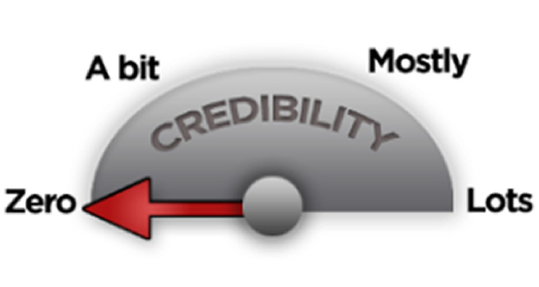
How will Biden’s climate plan affect everyday life- Daily Mail (Conclusion)
In conclusion to evaluating this news source Daily Mail and the article “How will Biden’s climate plan affect everyday life” you can conclude that this news source and article are misleading because all the questions were not able to be answered so this news source is not credible. The information given from the article was misleading.

